Slide 1

Playing against S&P 500
Project about investing in Stocks of the S&P 500 Index
Mid-Project by Jan Gfeller

Slide 2
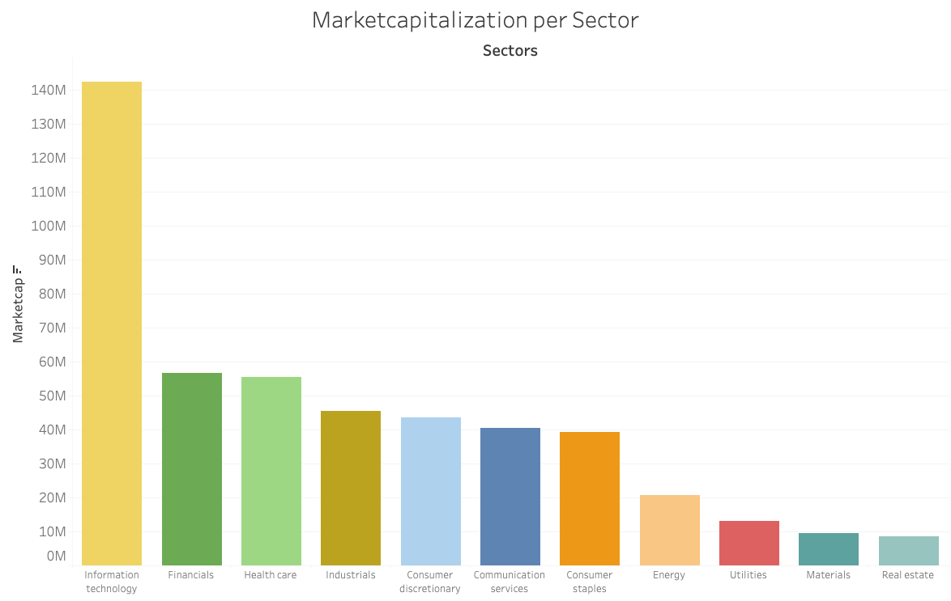
About S&P 500 Index
11 Sectors
126 Subsectors
500 of largest U.S. companies
Index for overall market
Notes:
important for overall market sentiment

Slide 3
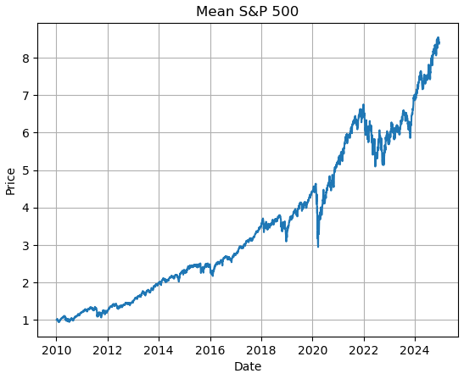
Exploratory Data Analysis
Statistics:
4 Mio. rows
Starting 1960
1 Entry per day/Stock
Notes:
to test data
short analysis:
normalized price data
average of all s&p 500 stocks:
8.5 x since 2010
long term investing seems to pay out
2022: large dip because of war in ukraine

Slide 4
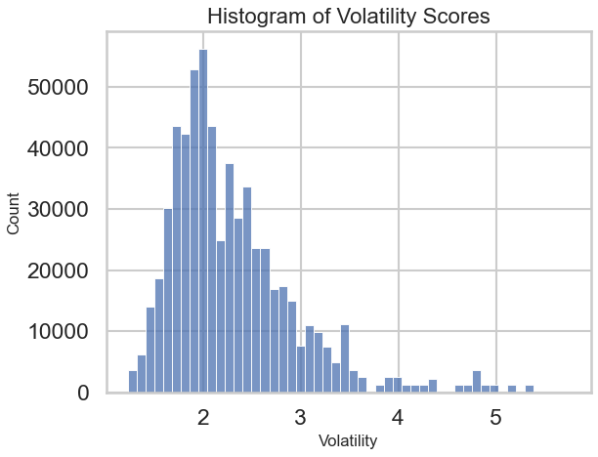
Inferential Statistics
Null Hypothesis:
No difference in volatility over different sectors
Alternative Hypothesis:
There is a difference in volatility visible
Notes:
regarding volatility:
day to day volatility
--> per stock:
price change =
percentual difference to day before
standard deviation
aggregated sectors

Slide 5
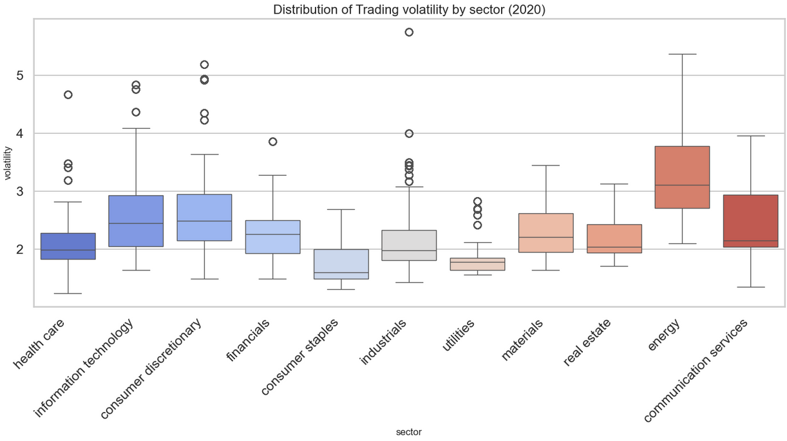

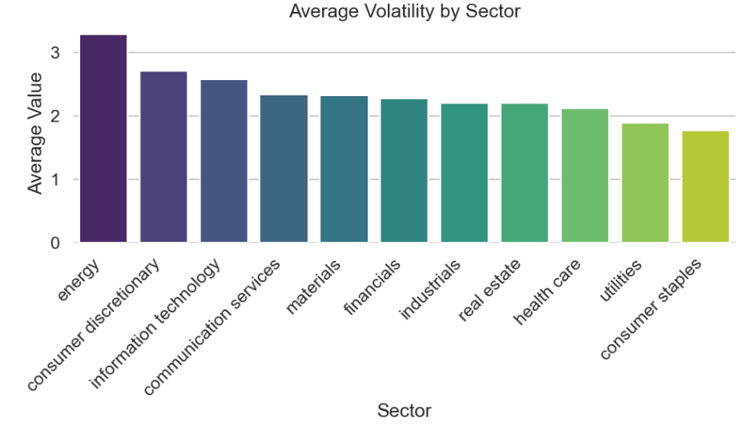
Inferential Statistics
one-way ANOVA
p-Value = 1.4 * e-22
Notes:
very low p-value
--> we clearly reject null hypothesis
energy has high median and overall
on the other side:
consumer staples, utilities
--> lower volatility values
right side:
ranked from high to low volatility
significant difference

Slide 6
Feature Engineering
Original Columns:
Date
Company
Prices (open, close, high, low)
Volume
Dividends
Stock Splits
Web Scraping:
Marketcap
Sector
Subsector
Feature Engineering:
Norm Price
Price Change
Volatility
Averages (MA & EMA)
Bollinger Bands
RSI
MACD
Notes:
preparation for machine learning
used some of the original features,
added some using webscraping,
added with feature engineering
already talk about:
norm price
price change
volatility
added financial indicators:
moving averages
also exponential
bollinger bands:
standard deviation x2
RSI:
relative strength index
indicates overbought / oversold conditions
not in the same scale as price data
MACD:
Moving Average Convergence/Divergence
another important trading indicator

Slide 7

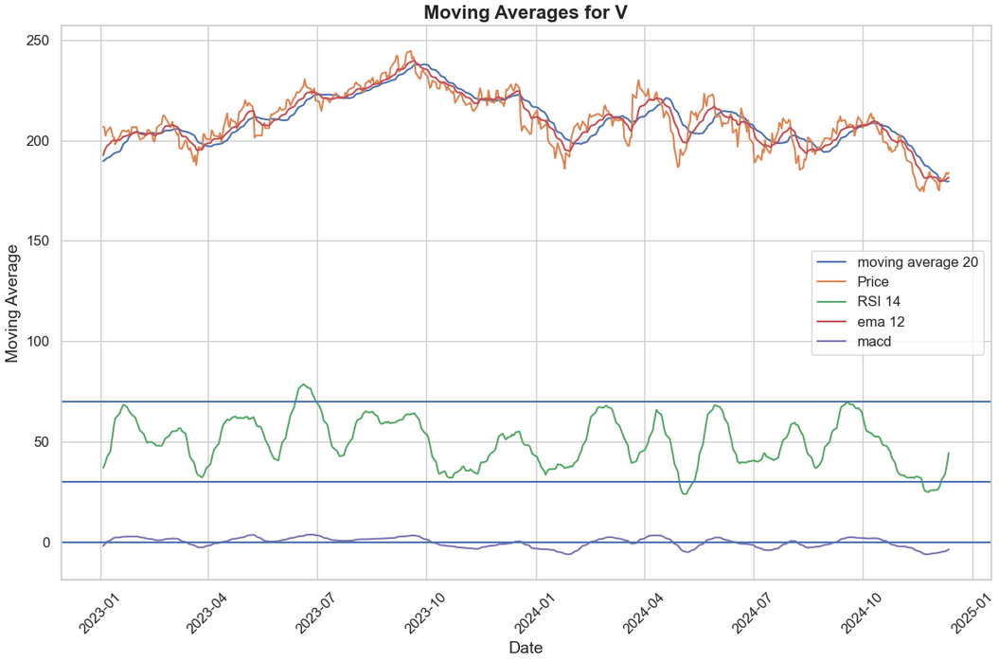
Feature Engineering
Original Columns:
Date
Company
Prices (open, close, high, low)
Volume
Dividends
Stock Splits
Web Scraping:
Marketcap
Sector
Subsector
Feature Engineering:
Norm Price
Price Change
Volatility
Averages (MA 20 & 60)
Bollinger Bands
RSI
MACD
Notes:
example price data for one stock

Slide 8

XG Boost
Training Data: 1960 - 2021
Preprocessing
lagged features
drop categoricals
default settings
Metrics: Profit on Portfolio
2022: -25%
2023: +53%
2024: +36%
Test:
2022 - 2024
Notes:
start machine learning with xg boost
- works well with large datasets
- does not care about outliers too much
- already know some of the parameters from previous experience
lagged features:
technical indicators
--> shifted for 1, 2, ... days
metrics: profit on virtual portfolio: invested in 10 top predicted profit stocks
non tuned model
already good numbers
want to make use of the categorical features
categoricals:
0ne-hot encoding: over 600 new features
--> way too much
integer encoding: implies an order but there is no order
researched opportunities
neural networks are great with this kind of categorical data

Slide 9

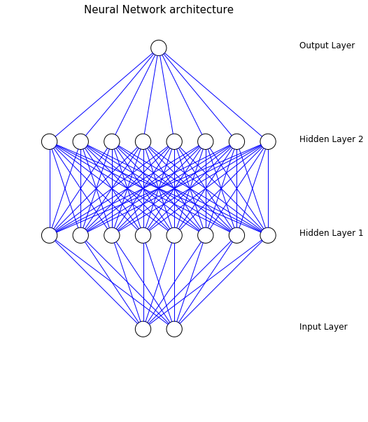
Keras
High level Python library
Built on top of Tensorflow
Components:
Embedding, Flatten: used for Input Categoricals
Dense: Basic Building Block
Optimizer: Adam
Notes:
tensor flow:
deep learning framework
logic behind deep learning model: different layers:
- input layer: every categorical feature needs own layer
embedding + flatten
- hidden layers: where the magic happens
dense layers (basic building blocks), lstm (long short term memory) for time series predictions
- output layer for predictions
adam:
optimizer
Adaptive Moment Estimation
efficiently adjusts the weights while training,
not include in further steps of project, focus on xg boost model

Slide 10
Streamlit

Slide 11


To do:
Code:
Restructure, Clean Up,
Implement best practices
XG Boost:
Refine, Grid Search
Keras:
Fix, Refine,
add LSTM
Streamlit:
Enhance,
Add second Risk profile
Notes:
keras
not sure if it works entirely as it should
--> potential
second risk profile
top predicted profits
prefer more steady growth, a bit safer

Slide 12


Thank you!

